Slide 1

Sprint 3 Presentation
Golf Player Time Management
Adam Horle, Alyssa Beeker, Bailey Carlin, Daniel Teel, Elijah Hunt

Slide 2
Course Registration
Implemented as part of the registration processes for an account
Registration moved to login page
Checks to ensure that the provided course name is not already in use
Validates email format
6 character password minimum
Sets account to an admin account
Removed Google sign in to implement the course relationship
On registration it creates a new node in firebase
Node name is the course name
Creates children for holes 1-18
description, strokes to par, yards to hole

Slide 3
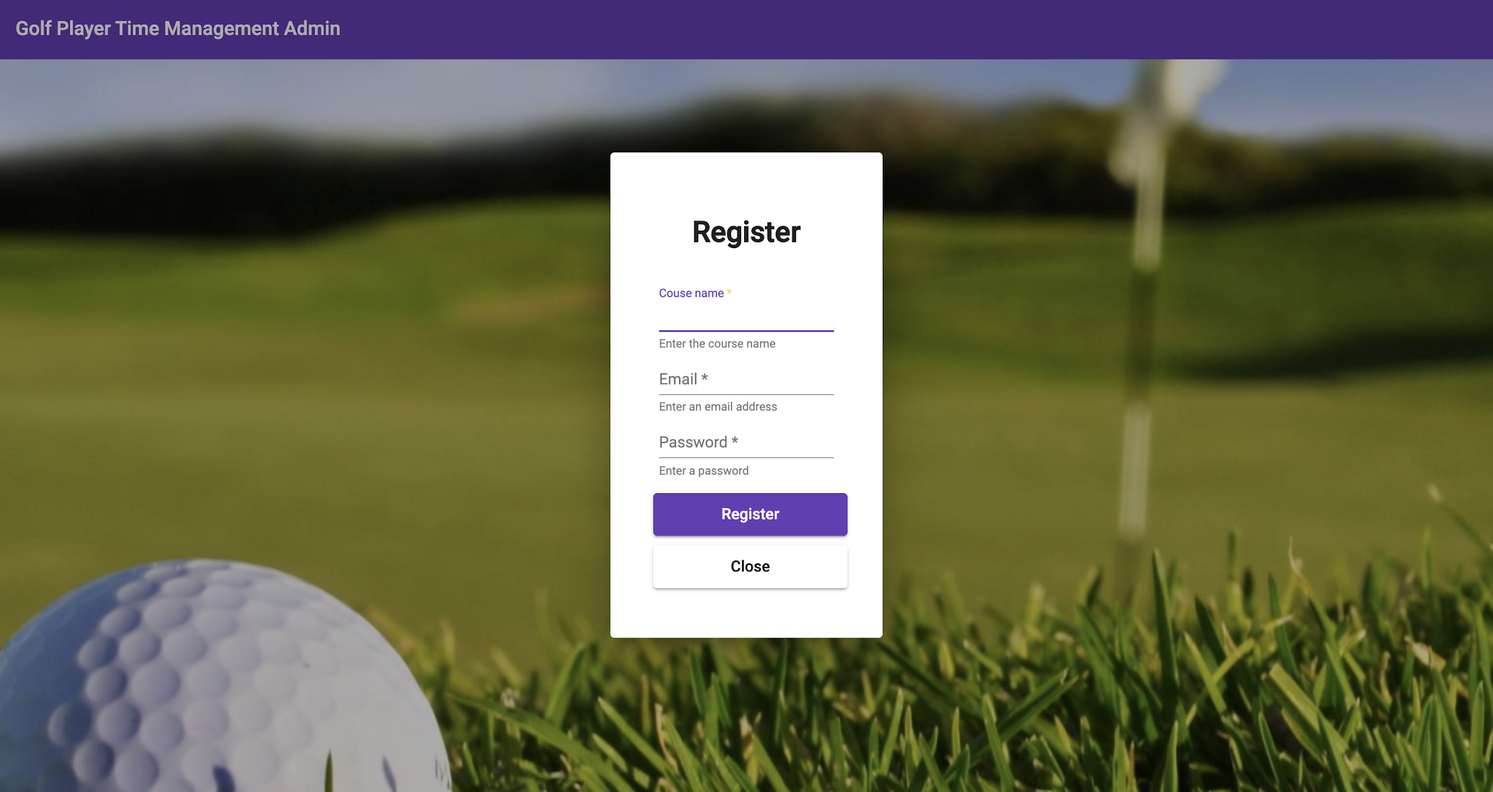

Slide 4
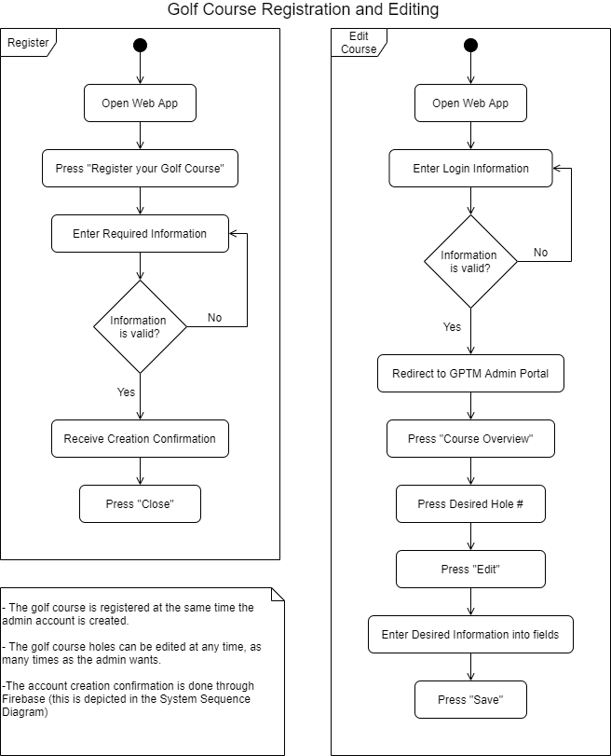
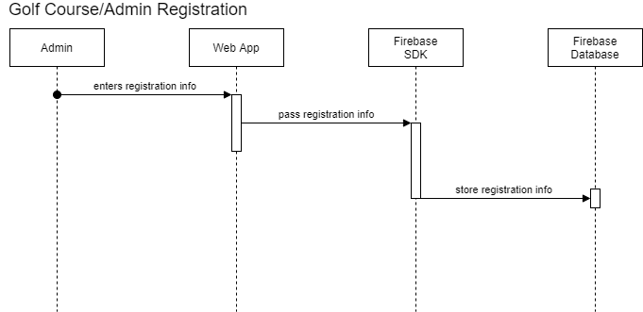
Course Registration Diagrams

Slide 5
Course Overview
Accordion tabs for holes 1-18
Hole information when accordions are expanded
Description, strokes to par, yards to hole
When expanded users can select the edit button and edit the fields
On save the data is updated in firebase
Course name at the top of the overview page as well as added to the toolbar

Slide 6
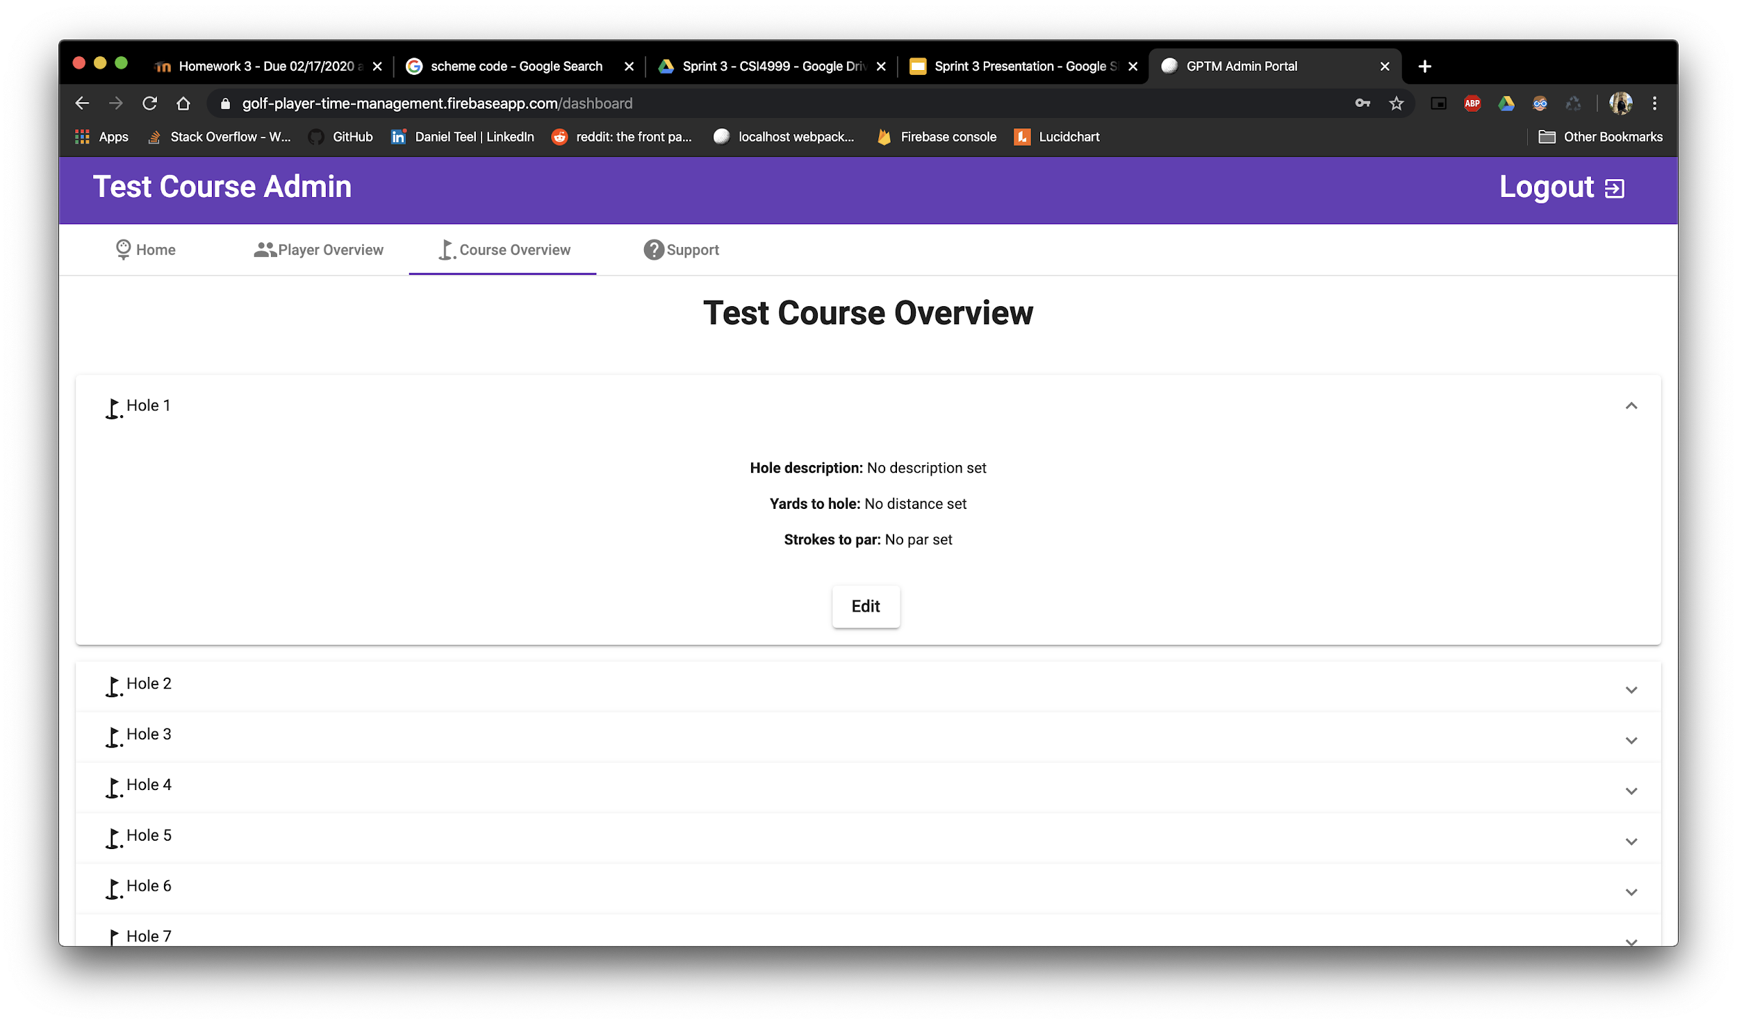
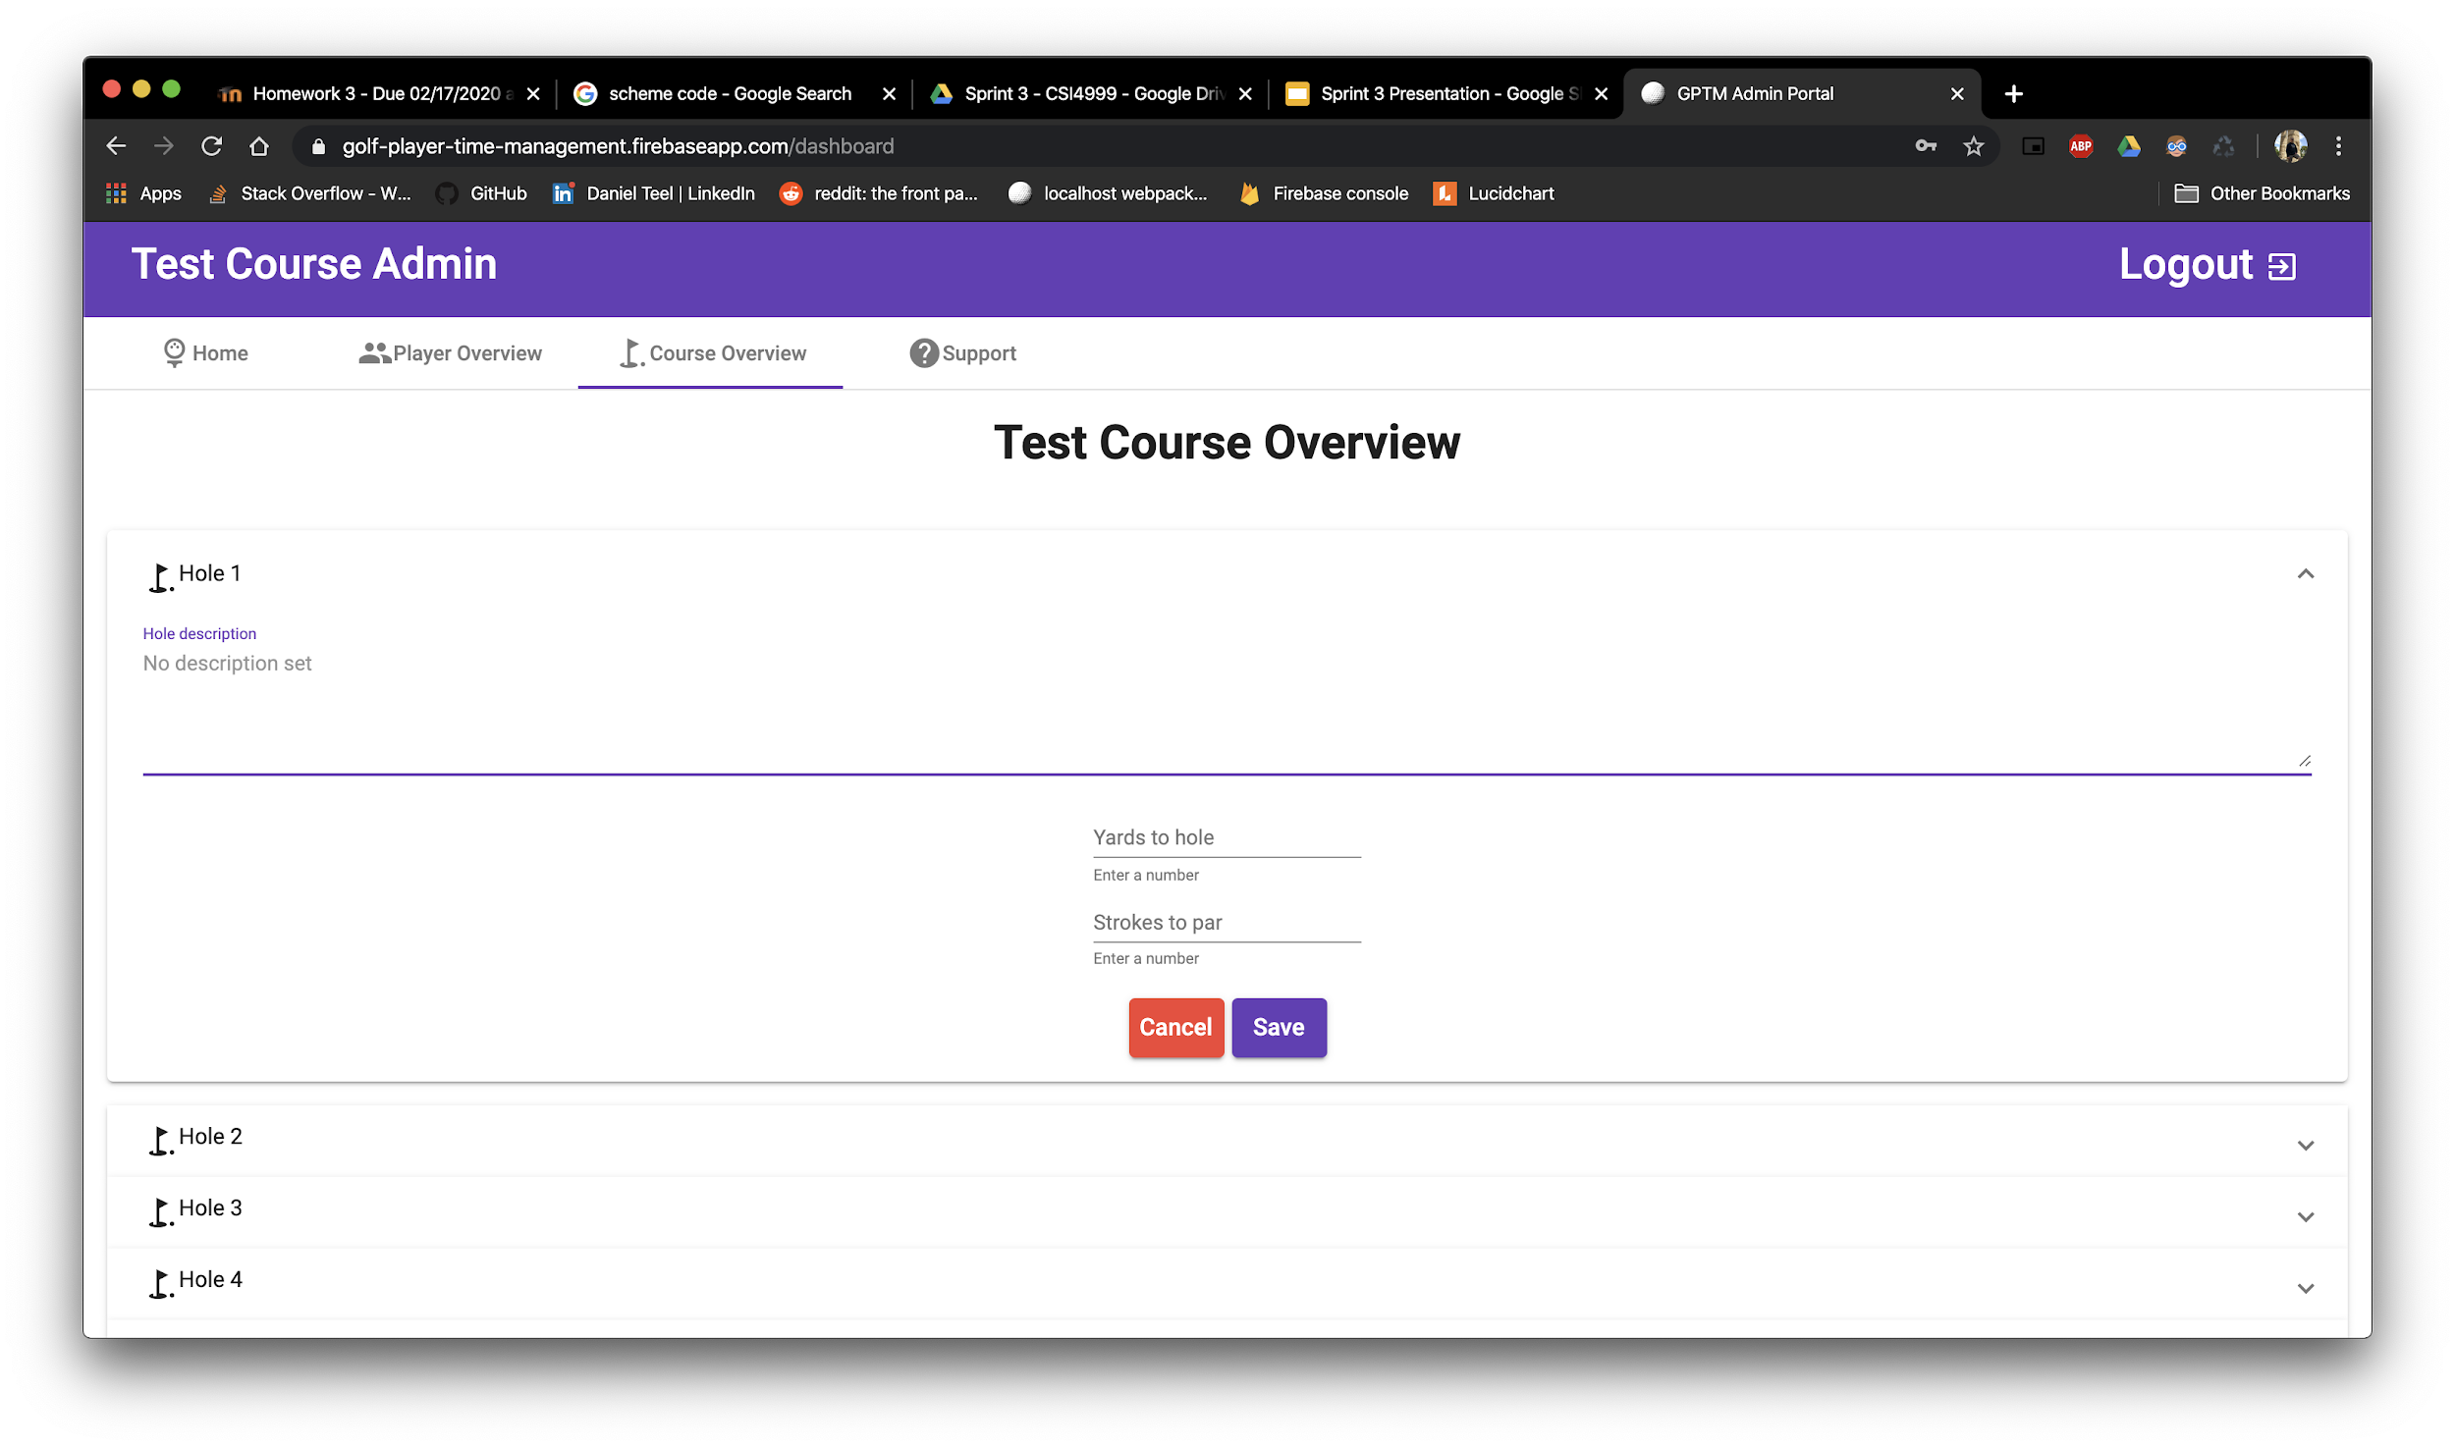

Slide 7
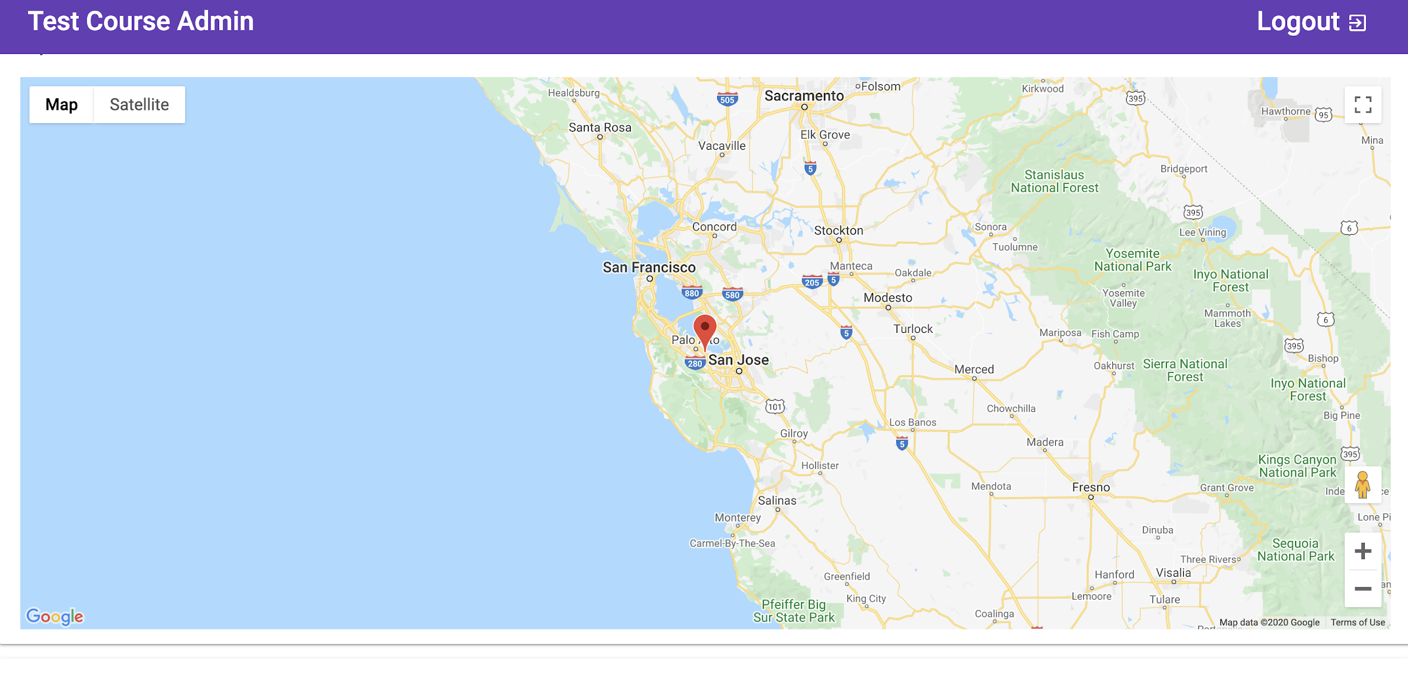
Google Maps API Integration
Read lat/long data from firebase (sent from the app)
Tracks players on a live map

Slide 8
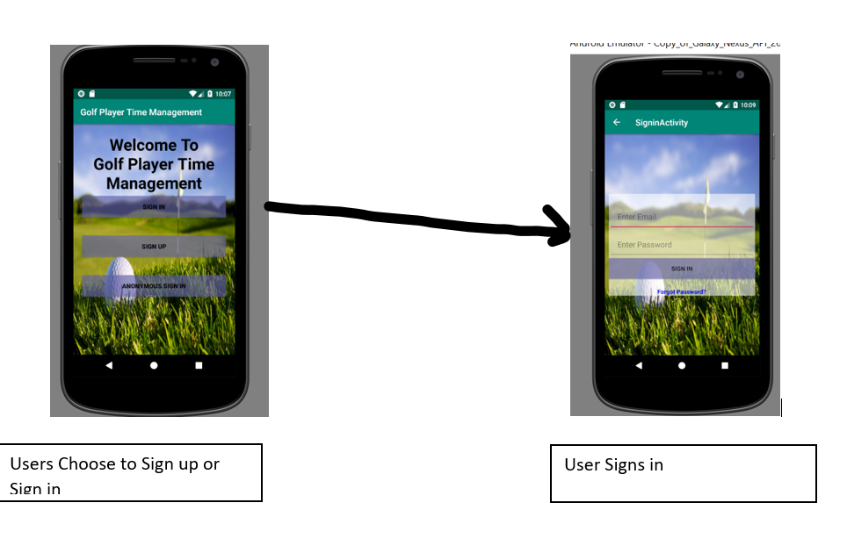
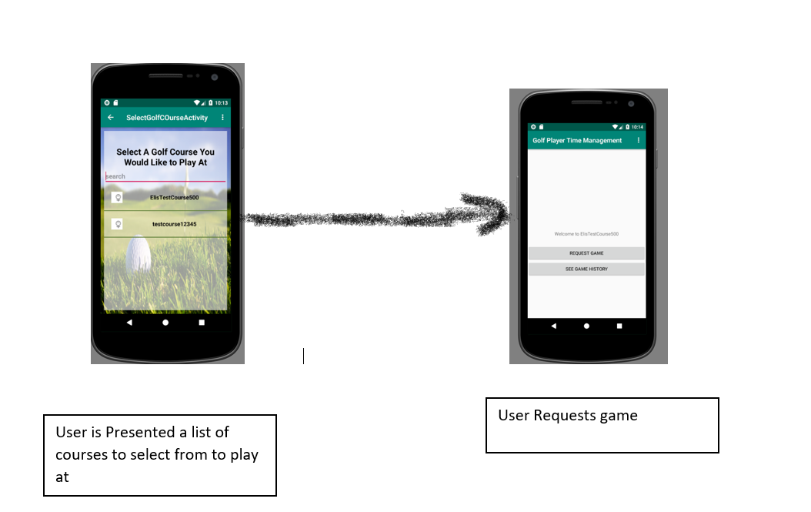
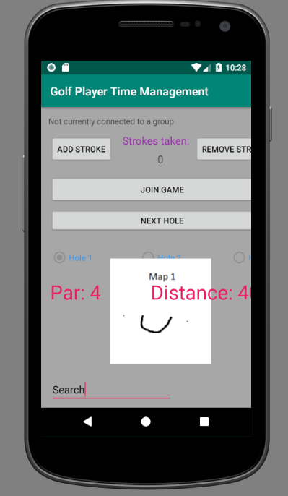
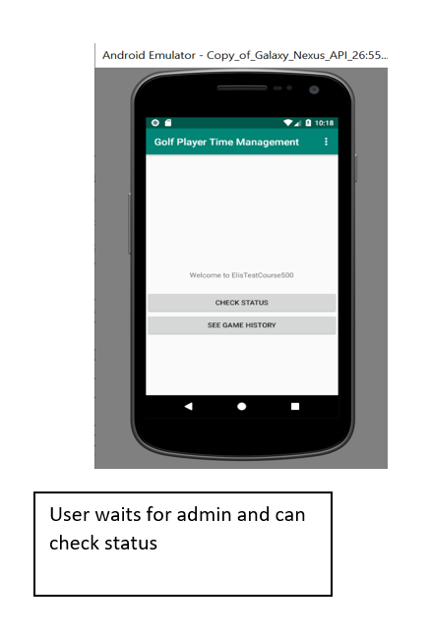
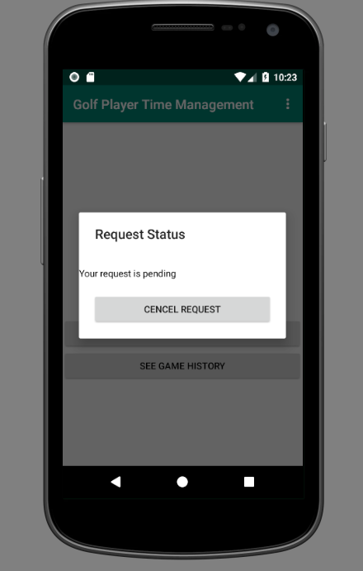
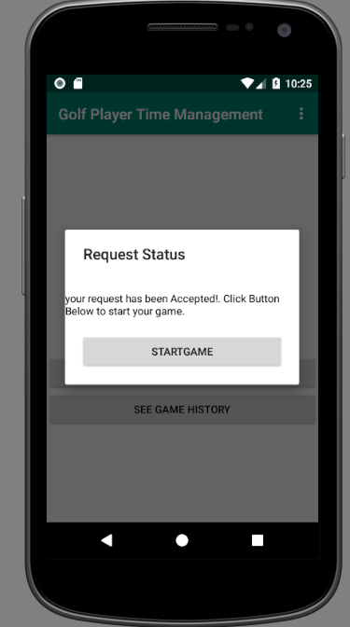
Mobile App Flow So Far
Dialog box comes up to check status. User and Cancel their request
Once admin accepts their game request, a new Start game Button will appear..
User Goes to game activity.

Slide 9
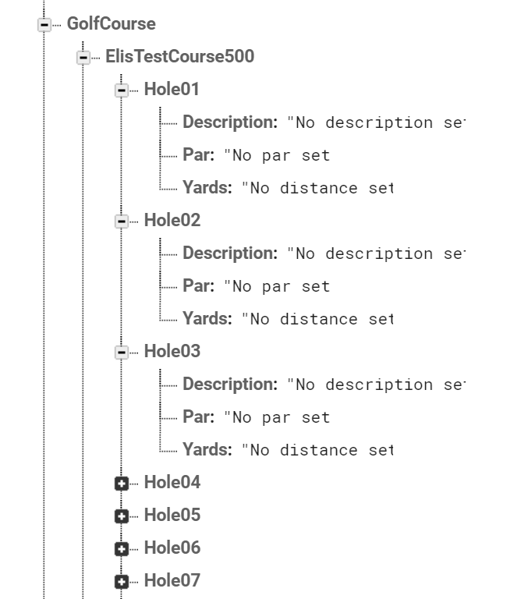
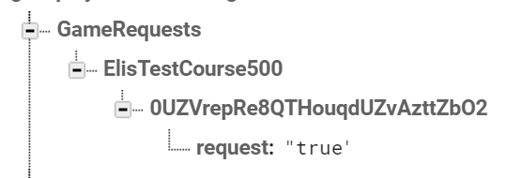
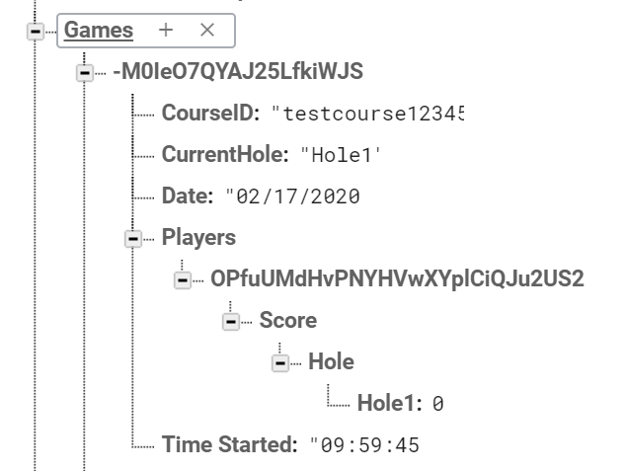
Database Structure
Golf Course Table
Game Request Table
Games Table

Slide 10
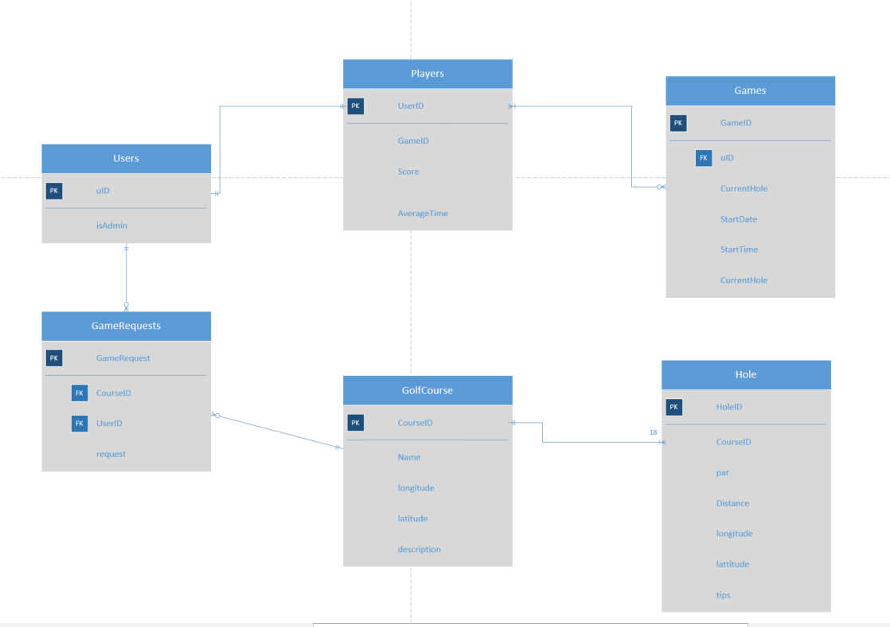
Rough Data Design

Slide 11
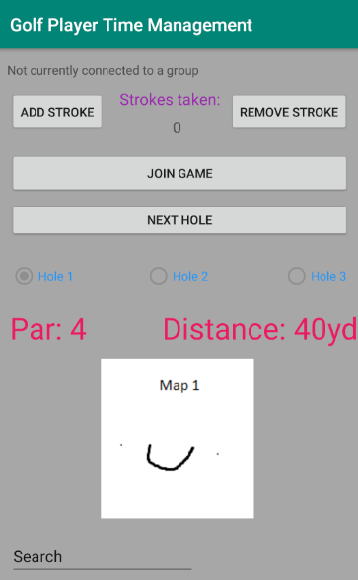
Game Activity
Tracks things like par for each hole, strokes, who/if you are
connected to a group, etc.
Added basic join feature
Only works if connecting to an actual user (not anonymous)
Shows current hole map (placeholder currently in place)

Slide 12
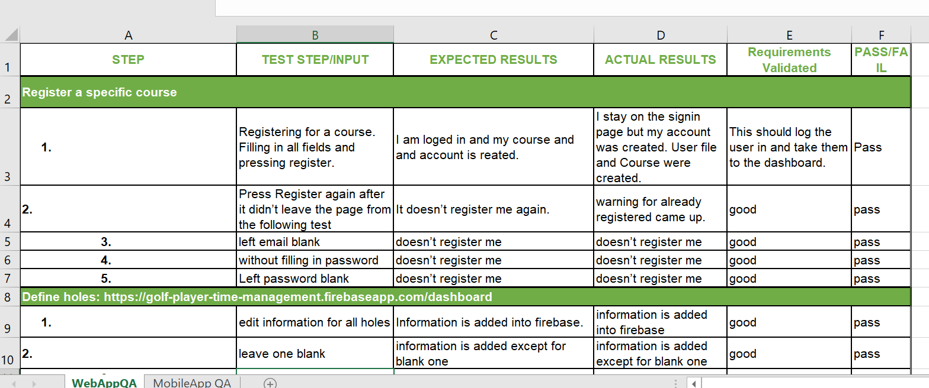
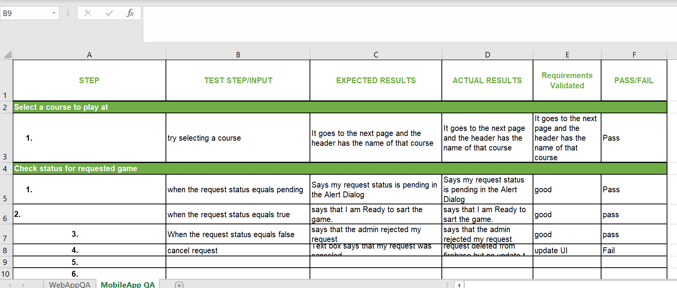
Quality Assurance
Web App
Mobile App

Slide 13
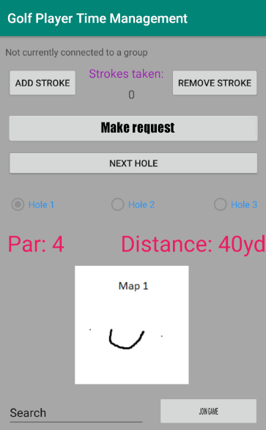
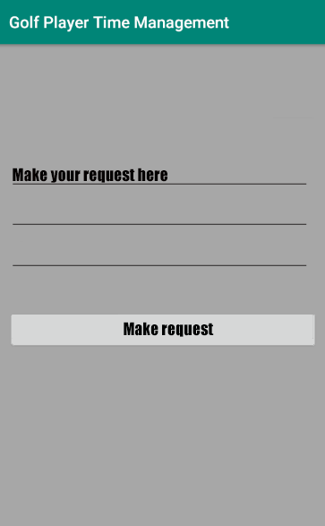
Next sprint UI/UX (mobile)
------------------------------------------->

Slide 14
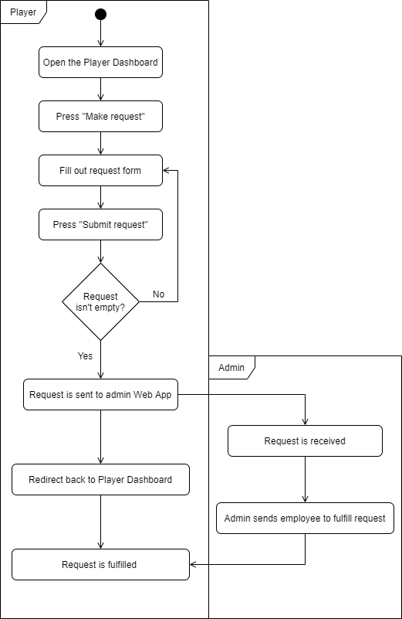
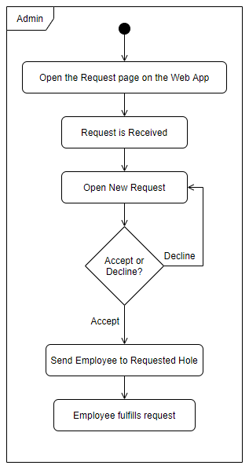
Next Sprint Activity Diagram

Slide 15
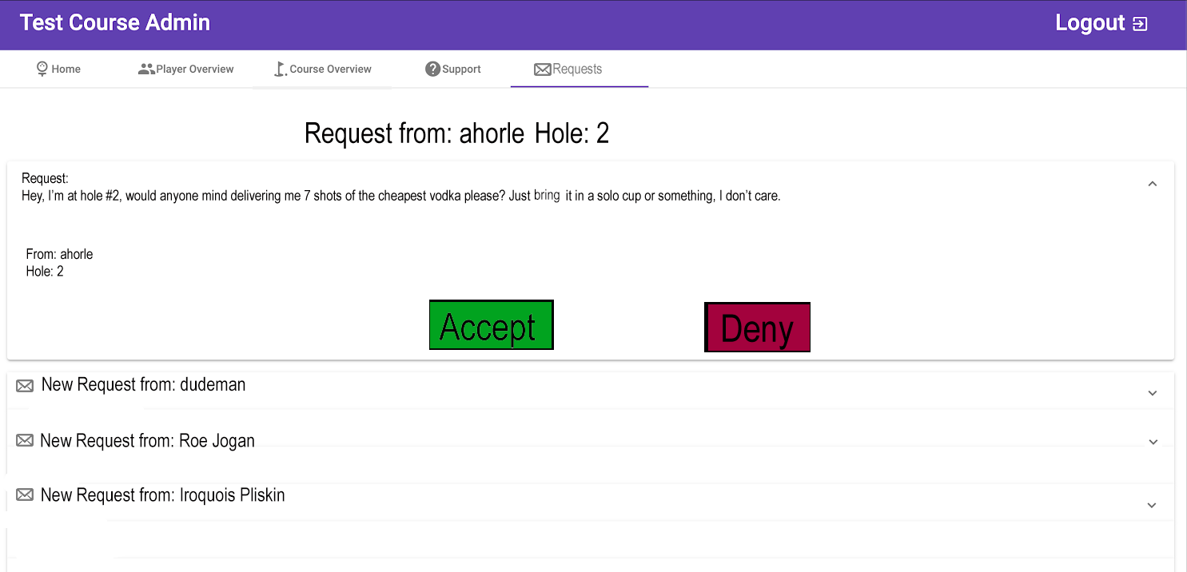
Next sprint UI/UX (desktop)

Slide 16
Next Sprint User Stories
As the golf course admin I would like to know which hole a player is at
As an administrator I would like to be able to accept or decline game requests
As a player I would like to receive some sort of notification if the request went through.
As a player I would like to receive some sort of notification if the request is denied.
As a player I would like to receive some sort of notification if the request is accepted.
As an administrator I would like some notification for receiving a request.
As an administrator I would like to be able to see all of my requests on the dashboard.
As an administrator I would like to see which user sent me the request.
As an administrator I think that only registered users will be able to make requests.\
As a player, I would like to keep track of my score.
As an administrator, I would like to see which players are on each hole.

Slide 17

Challenges Encountered
Scheduling conflicts
Workload from other classes
Working around the weird way firebase chose to create child names
User -> random string of chars and nums -> important info
Deciding what to do with group functionality

Slide 18

Sprint 4 Objectives
Geofence an actual golf course
Develop Player Overview tab in the Admin Dashboard
Google maps api to show player locations (in progress, nearly complete)
Table of active players with an action menu (approve/deny)
Player requests and assistance functionality
Continue to churn out documentation

Slide 19
Demo Link
https://golf-player-time-management.firebaseapp.com
https://youtu.be/UYzDB5D_nCI

Slide 20
Questions

